Slide 1
How to improve support to fulfil the
SLA

Slide 2
Table of contents
- Overview about the tool used
- Overview about the dataset
- Summaries you created
- General recommendations

Slide 3
Overview about the tool used
The tool used for the project is known as Microsoft excel
Microsoft Excel allows users to format, organize, and calculate data in spreadsheets.
By organizing data using software like Excel, data analysts and other users can make it easier to visualize information as data is added or changed.
Excel contains a large number of areas called cells that are classified into rows and columns.
The next slide gives an overview on the dataset

Slide 4
Overview about the dataset
The dataset is a ticket management system stored on excel
A ticket management system can be defined as robust software used to create, organize, prioritize, and resolve customer support tickets.
These tickets can be complaints or requests raised by your employees or your customers.
Moreover, every ticket management system comes with SLA software functionality.
Customers see organizations with dependable systems enhanced with SLA functionality—like the Mint ServiceDesk software—as more respectable and dependable.
Additionally, the SLA function enhances the work of technical departments, preventing circumstances when there are delays or a failure to reach the agreed-upon service delivery time.

Slide 5
What is an SLA?
Service Level Agreements, or SLAs, are precise agreements on a level of service supply that is guaranteed.
The paper outlines the technical specifications, scope, and minimum level of service that is provided.
Records have to contain the issues that have been reported, the beginning and ending dates of the service, the amount of time invested in finding a solution, and instructions on how to track advancement.
Accurate records and well determined business processes—which need to be developed in a transparent and quantifiable way—are the foundation for SLA effectiveness.

Slide 6
Breached SLA
An SLA violation is what? Your agents failing to finish their cases on time is a service level agreement (SLA) breach (or violation). By not helping them within a specific time frame, you've effectively betrayed a commitment to your clients.
Likewise, in simple terms it is when the Last Updated Date exceeds the SLA Due date.

Slide 7
Summaries created
When going through the excel sheet various summaries were created such as:
Total tickets per team
Total tickets per priority
Total tickets per type
Tickets booked per username
Agents with the most teams assigned
Total tickets by department
Tickets by subject
Total open/unanswered tickets
Users with the most emails by priority
Tickets by date range(year)
etc

Slide 8
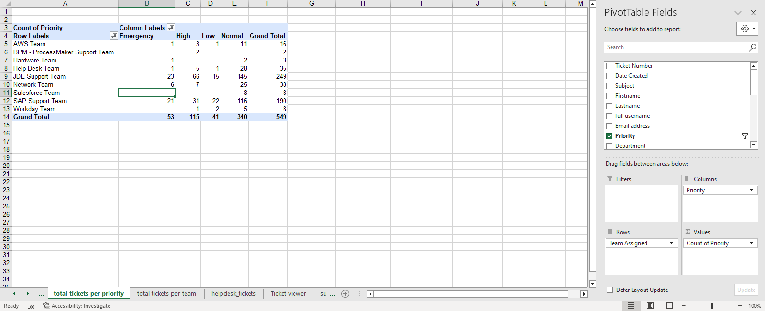
Summaries created part 2
Furthermore, pivot tables were created which is another form of epitomizing data.
An example has been placed by the side.

Slide 9
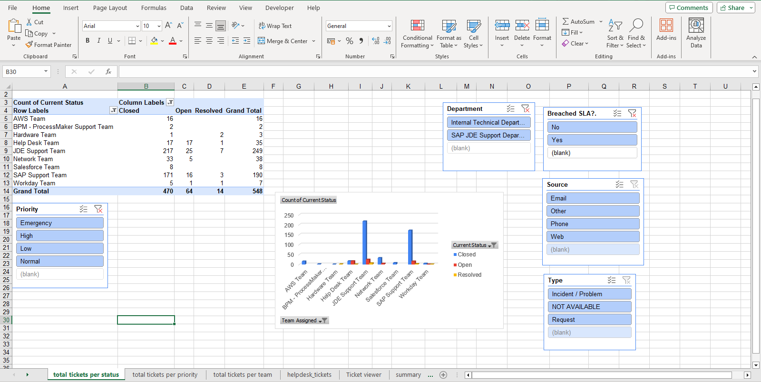
Using pivot tables and slicers

Slide 10
General recommendations
The service provider providing a solution to the SLA problem.
If the issue was reported after the occurrence, then there has been a service level violation and the issue's record is legitimate. Nevertheless, it is important to remember that the issue must be reported within the SLA-agreed timeframe.

Slide 11
Tips to Prevent SLA Breach Circumstances
Construct a structure that is capable of tracking and warning. The procedure might be automated to alert or direct potential breaches to the right people.
A frequent evaluation of the SLA is also necessary to ensure that it remains realistic and relevant at all times.
Factor in the SLA while designing the service and not at a later stage

